Slide 2
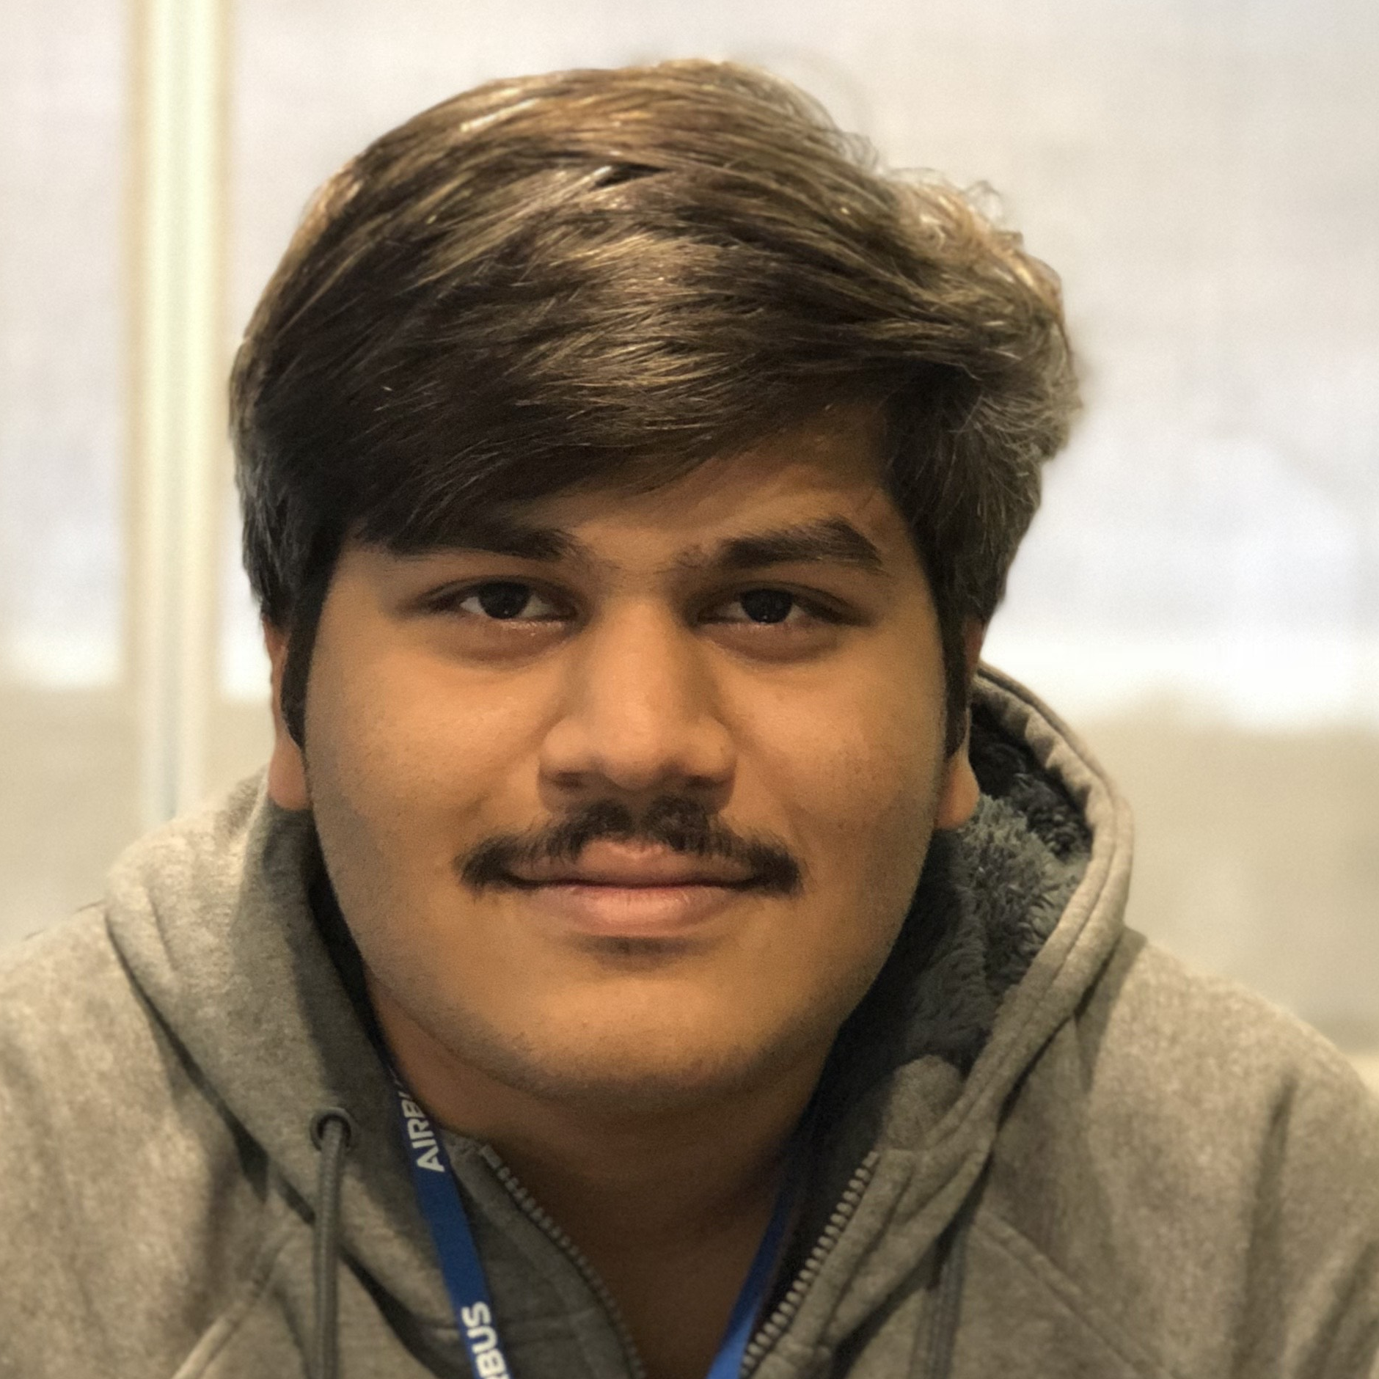
Team
Problem & Solution
Sailesh Rajanala
Research & Contributions
Computer Science
Lead
Lead

Slide 3
Team
“ Team Lotus ”
Interdisciplinary Team
Computer Science
Computer Engineering
All of us are International students

Slide 4
Team Lotus
NAME | ROLE | DISCIPLINE | EXPERTISE
Sailesh Rajanala | Lead | Computer Science | Web Designer/Developer
Priyanka Limbu | Time Keeper | Computer Science | Database Developer
Shiva Karki | Facilitator | Computer Science | Database designer
Subash Acharya | Scribe | Computer Engineering | Back-end Programmer
Waryam Mazhar | Project Manager | Computer Science | Security, front-end developer

Slide 6
Problem
Department specific Senior Design Course
Department specific list of Contacts
These Lists are
static
not updated regularly
in different formats
Instructors rely on same set of contacts for new projects
Gathering interdisciplinary sponsored projects has become a challenge

Slide 7
Solution
A unified Database on university’s web server
Stores all the lists as one dynamic list
Simple and easy to use
Industry Partners fill the web form
Then, Database updates
Accessible to all Senior Design Instructors
All in One location to identify Industry, Research and Community Partners

Slide 8





Industry Partner Database
Proposed by Dr. Cindi Mason, Senior Design Instructor

Slide 10
Sailesh Rajanala
Role : Lead
Responsibility : Identify tasks, technologies, activities and deliverables
Contributions
Identifying Core Values of our project
Compatibility
Sustainability
Expandability

Slide 11




Contributions
Discord for Communication
Google Docs for Collaboration
GitHub for Version Control
Research
Prevention of Spam Entries
using RECAPTCHA

Slide 13
Technologies
Research & Contributions
Priyanka Limbu
Computer Science
Time Keeper

Slide 14
Technologies
php 7.4
Front End - webpage
HTML 5
CSS 3
Javascript
php
file
Back End - server
php 7.4
Database
MySQL

Slide 15
Contributions
Participated in various meetings with Stakeholders
Inquired about the license for technology
Keep track of meetings, minutes
Research
MariaDB
InnoDB

Slide 17
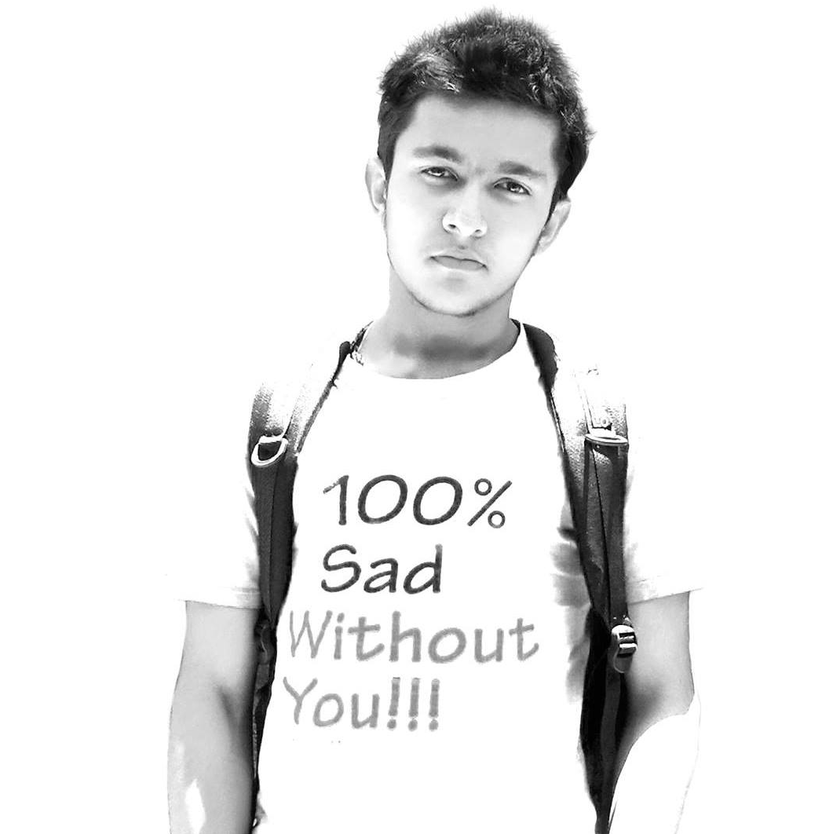
Working and Data Flow
Experience
Research
Coding Html, Css, Js and Php
Render Using Houdini
Subash
Acharya
Computer Engineering
Contributions
UI/UX design
Scribe
Dummy Website

Slide 18
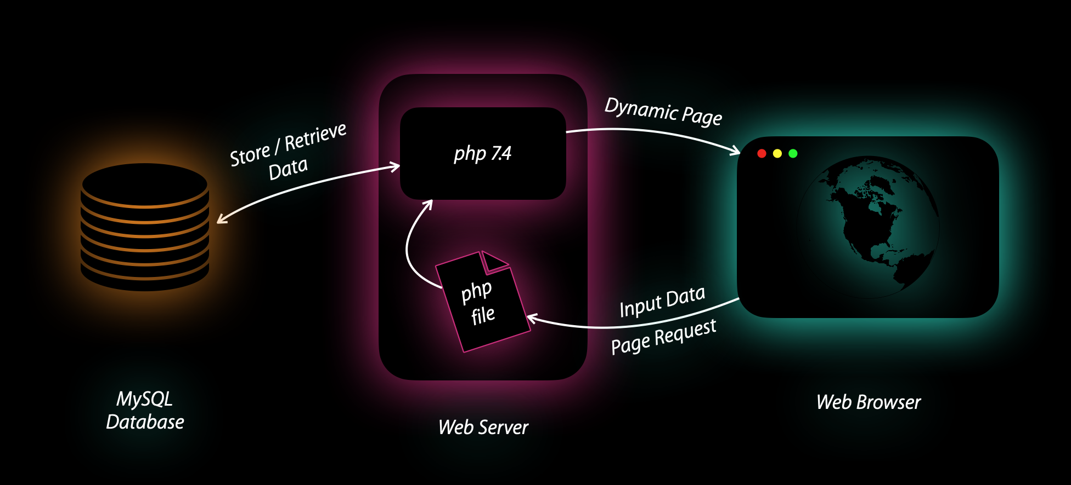
Working and Data Flow

Slide 19
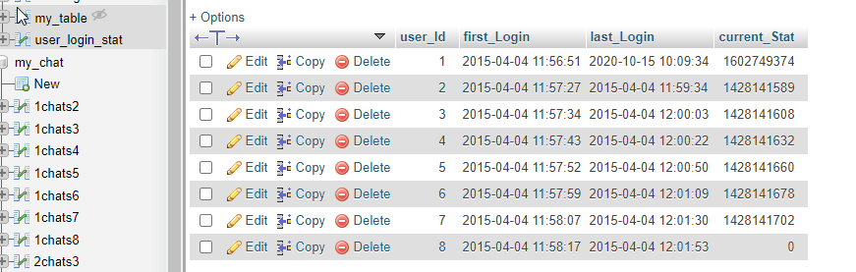
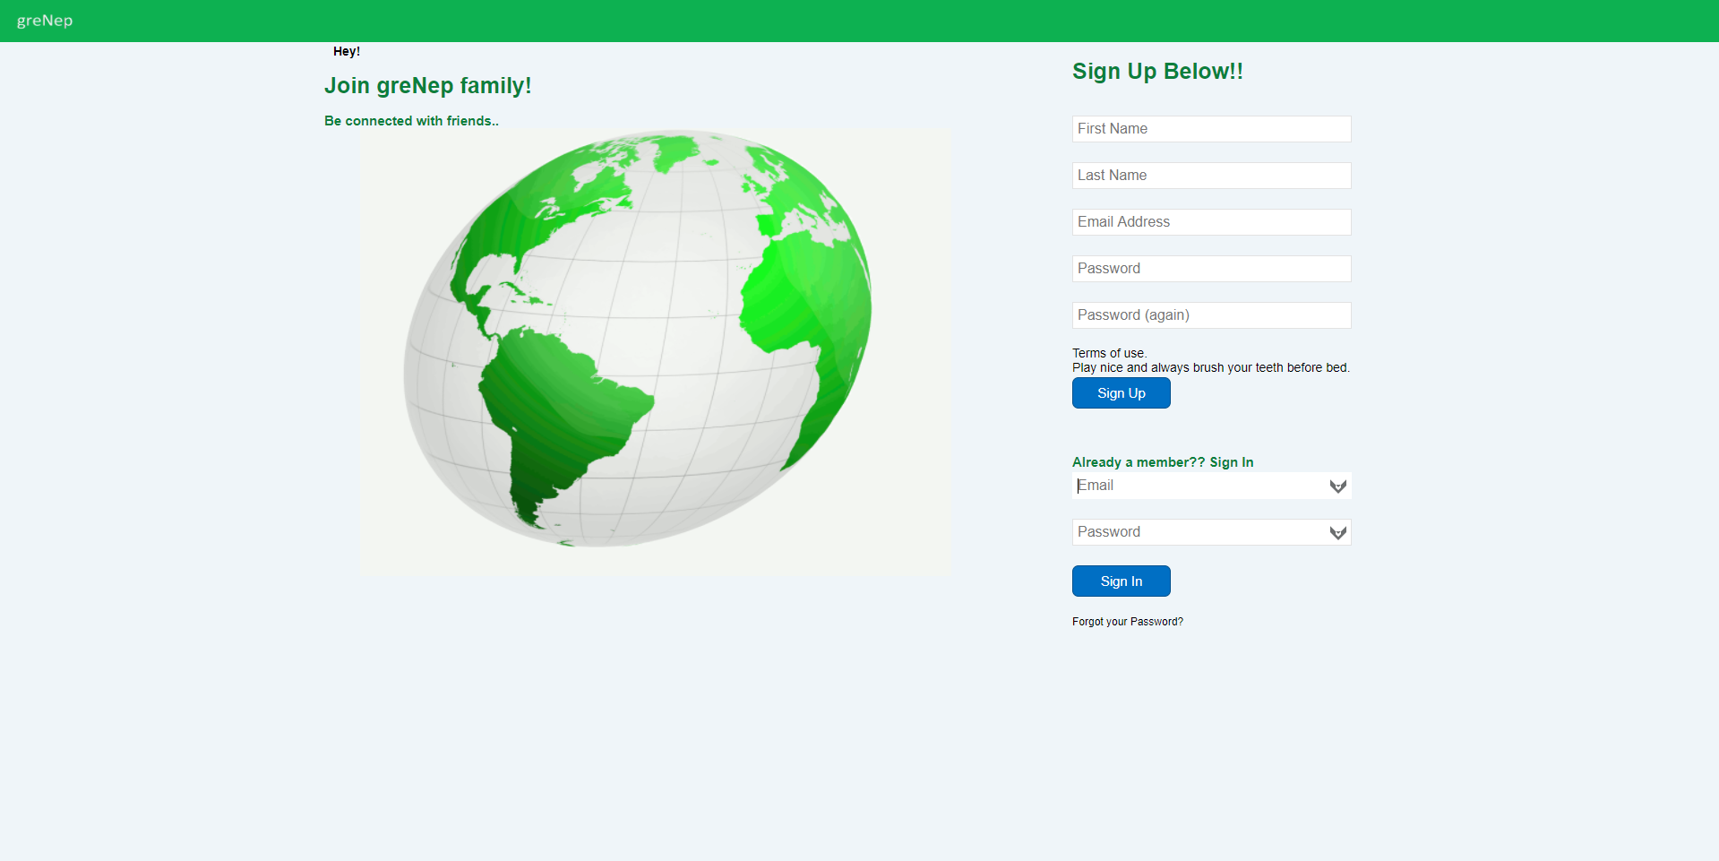
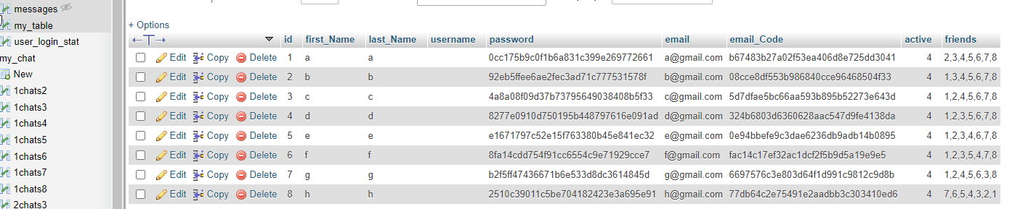
Experience
Previously worked on self made Social Networking website
which featured
Sign up and user email verification using salted link
Login and maintain Session
Ability to send and receive friend request and chat in real time using comet chat system
Deploy, Configure and maintain a webpage on
Amazon Web Service (AWS)
With this experience in hand, More focused on learning the updated versions of languages and security issues

Slide 20
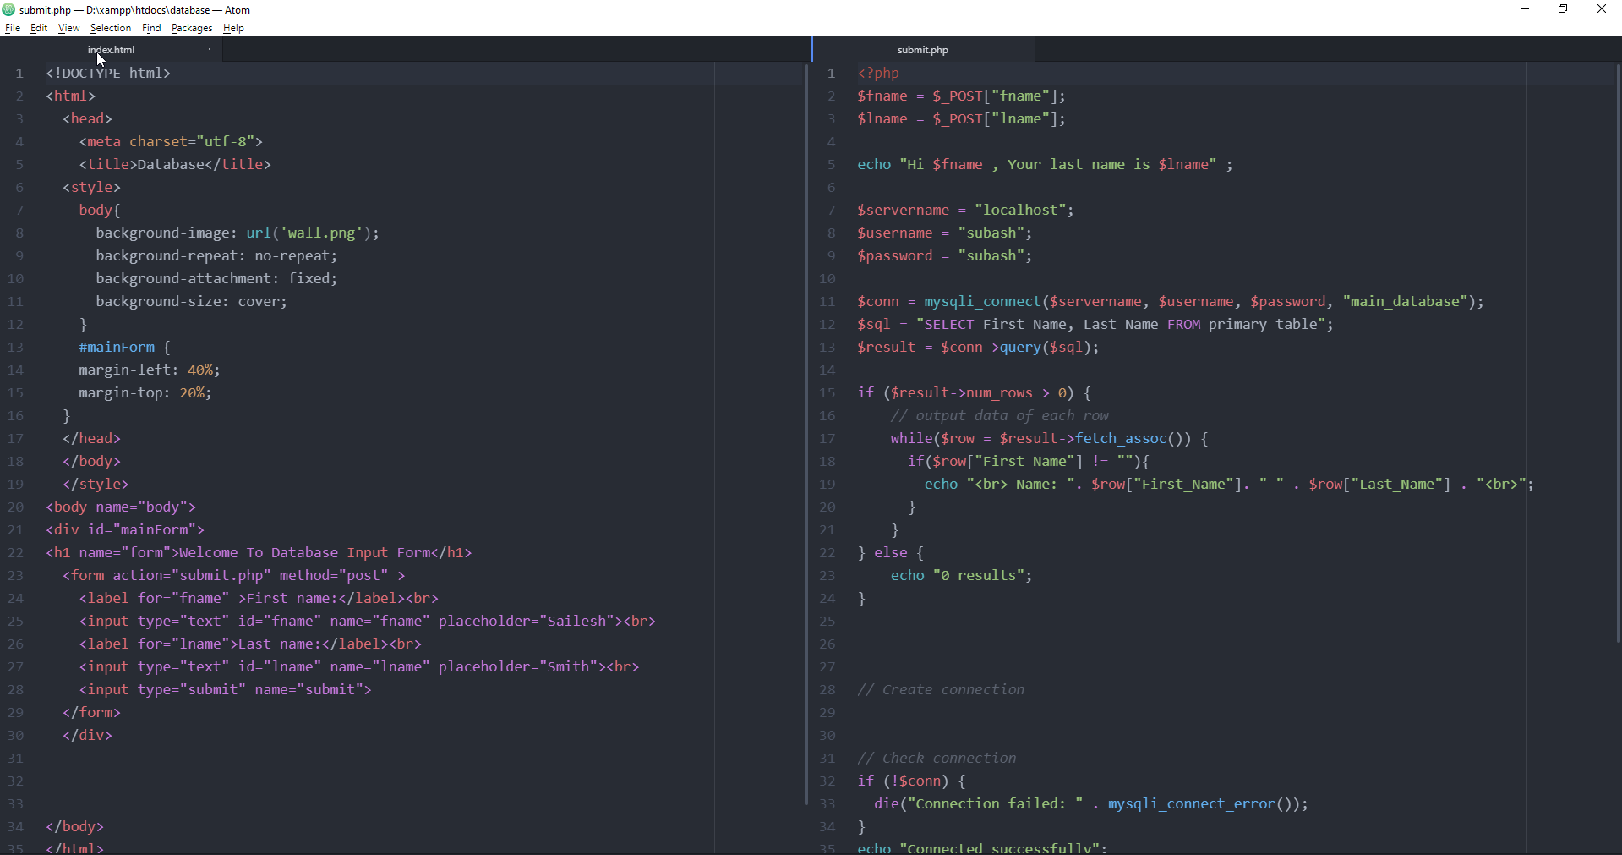
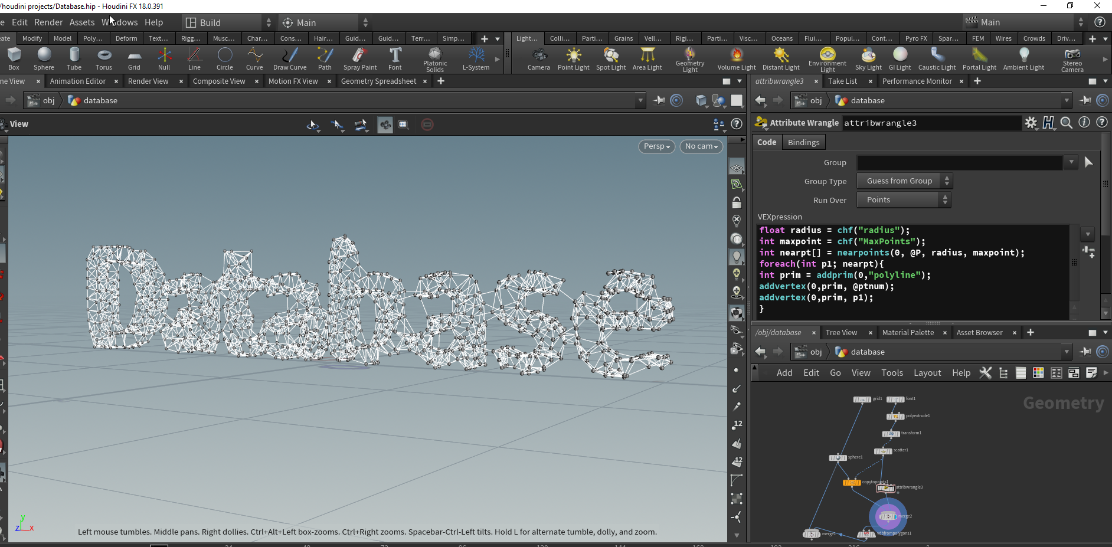
Research
Coding Html, Css, Js and PHP
Render Using Houdini
Node based procedural software used for motion graphics, VFX,
Simulation etc

Slide 21
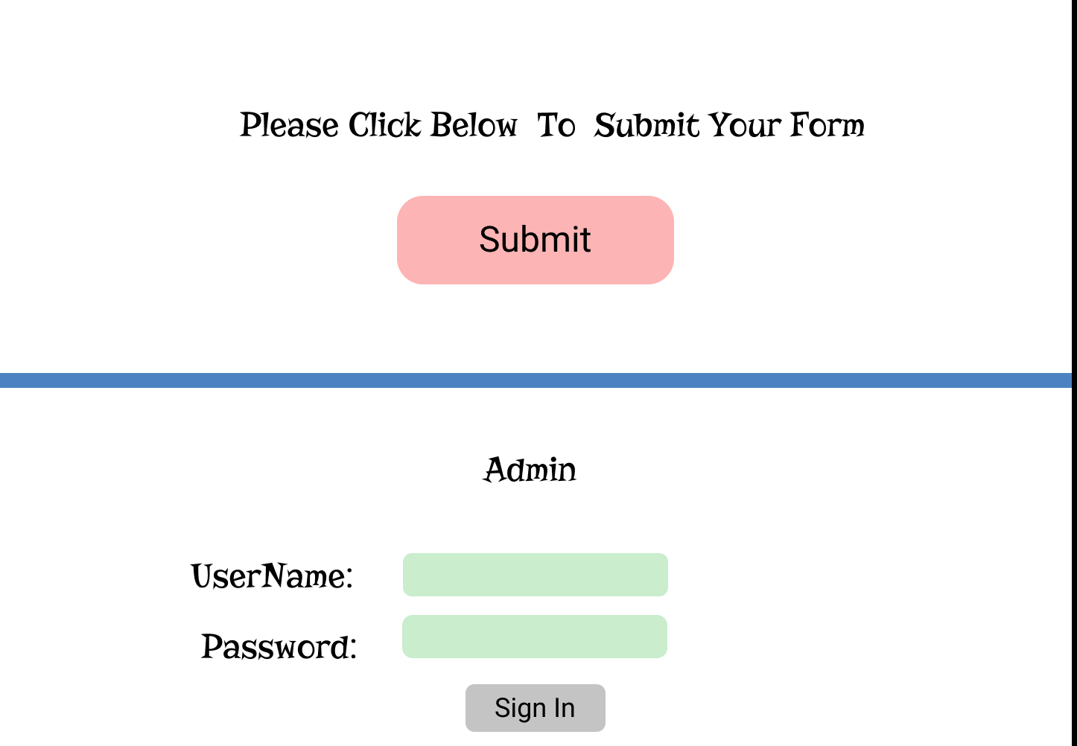
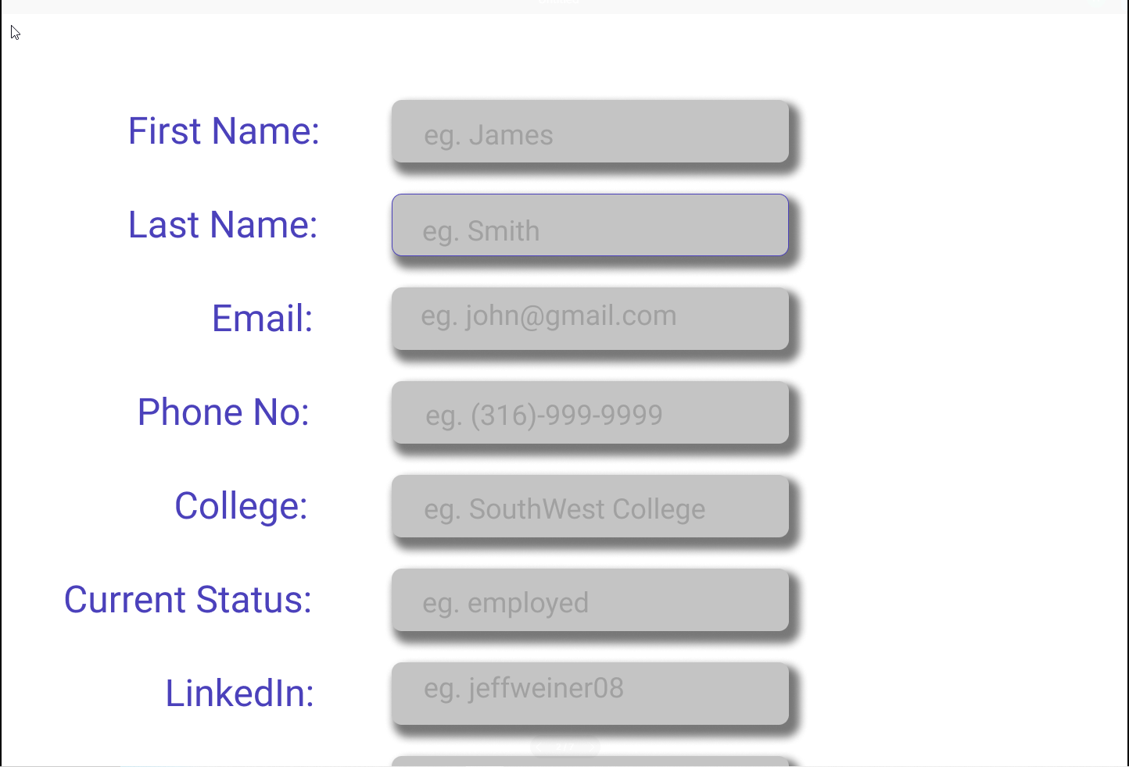
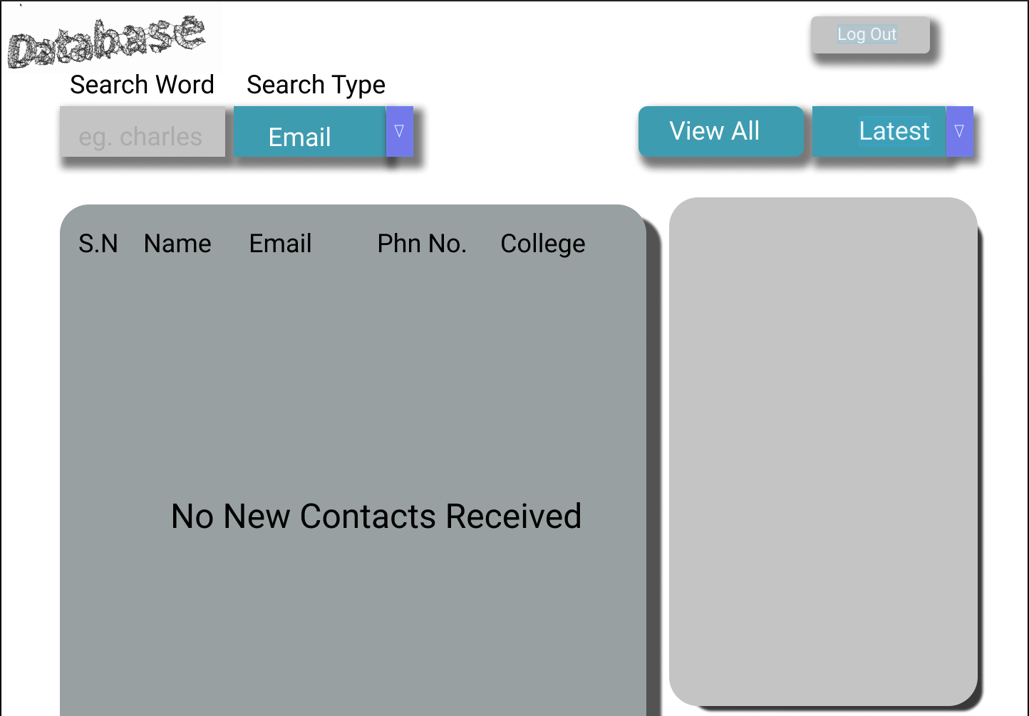
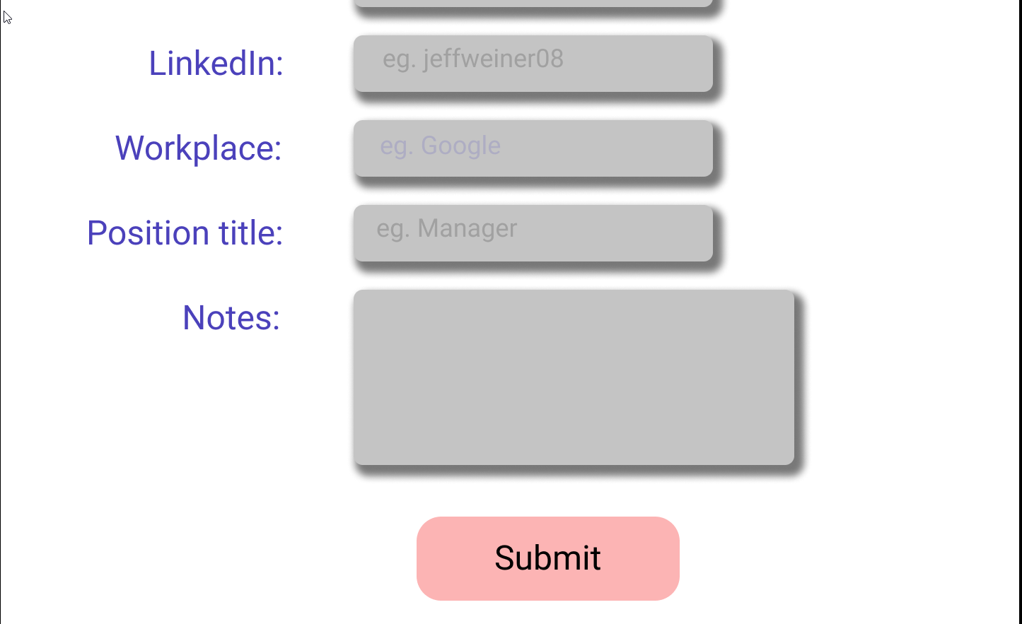
Contribution
UI/UX design

Slide 22
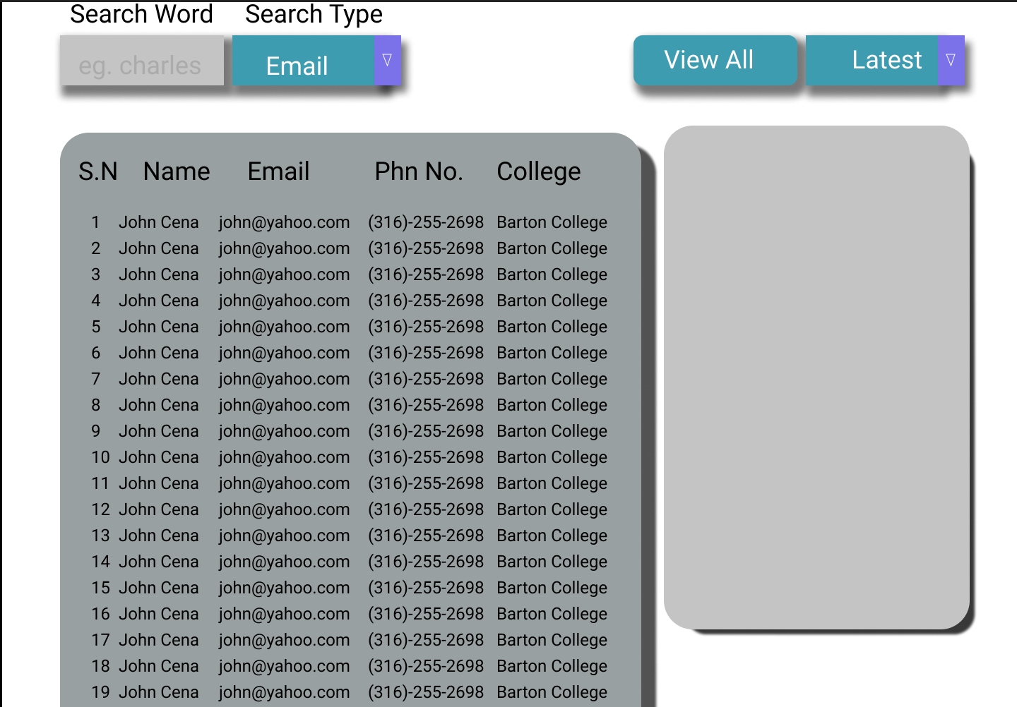
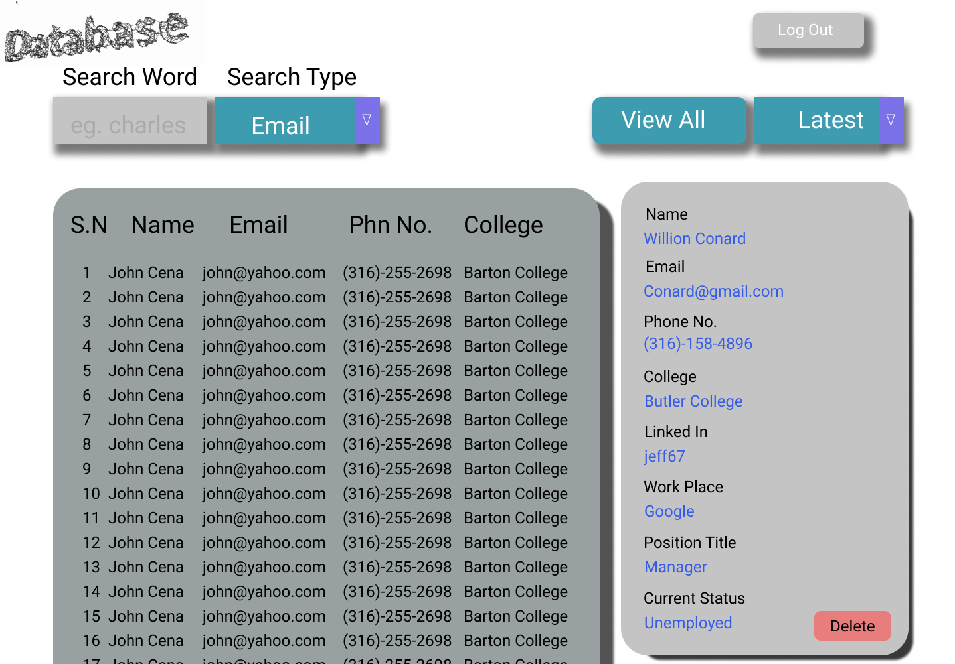
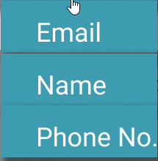
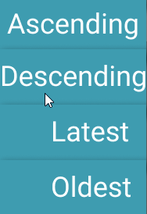
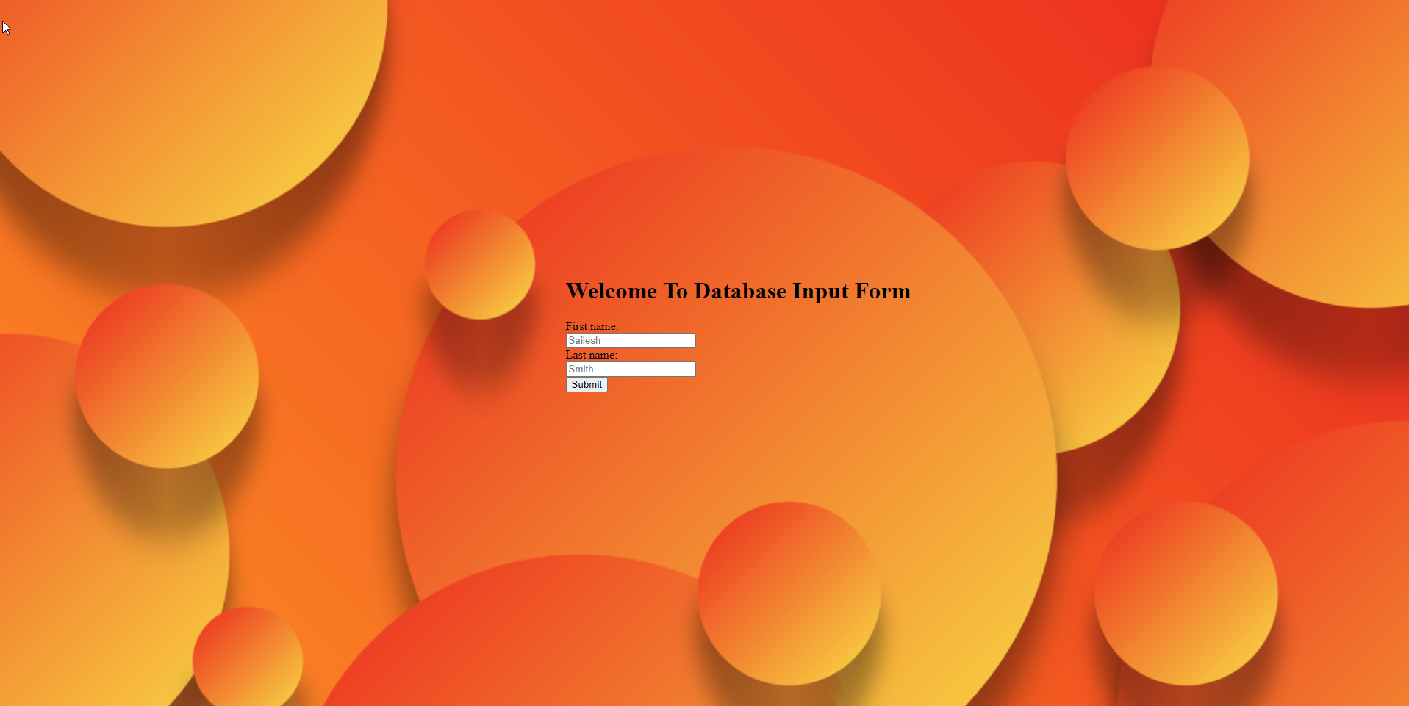
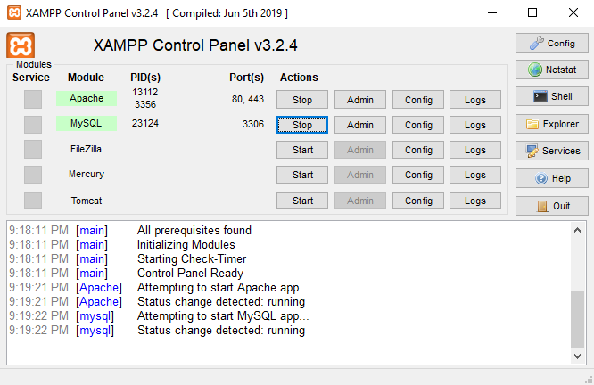
Dummy Website

Slide 24
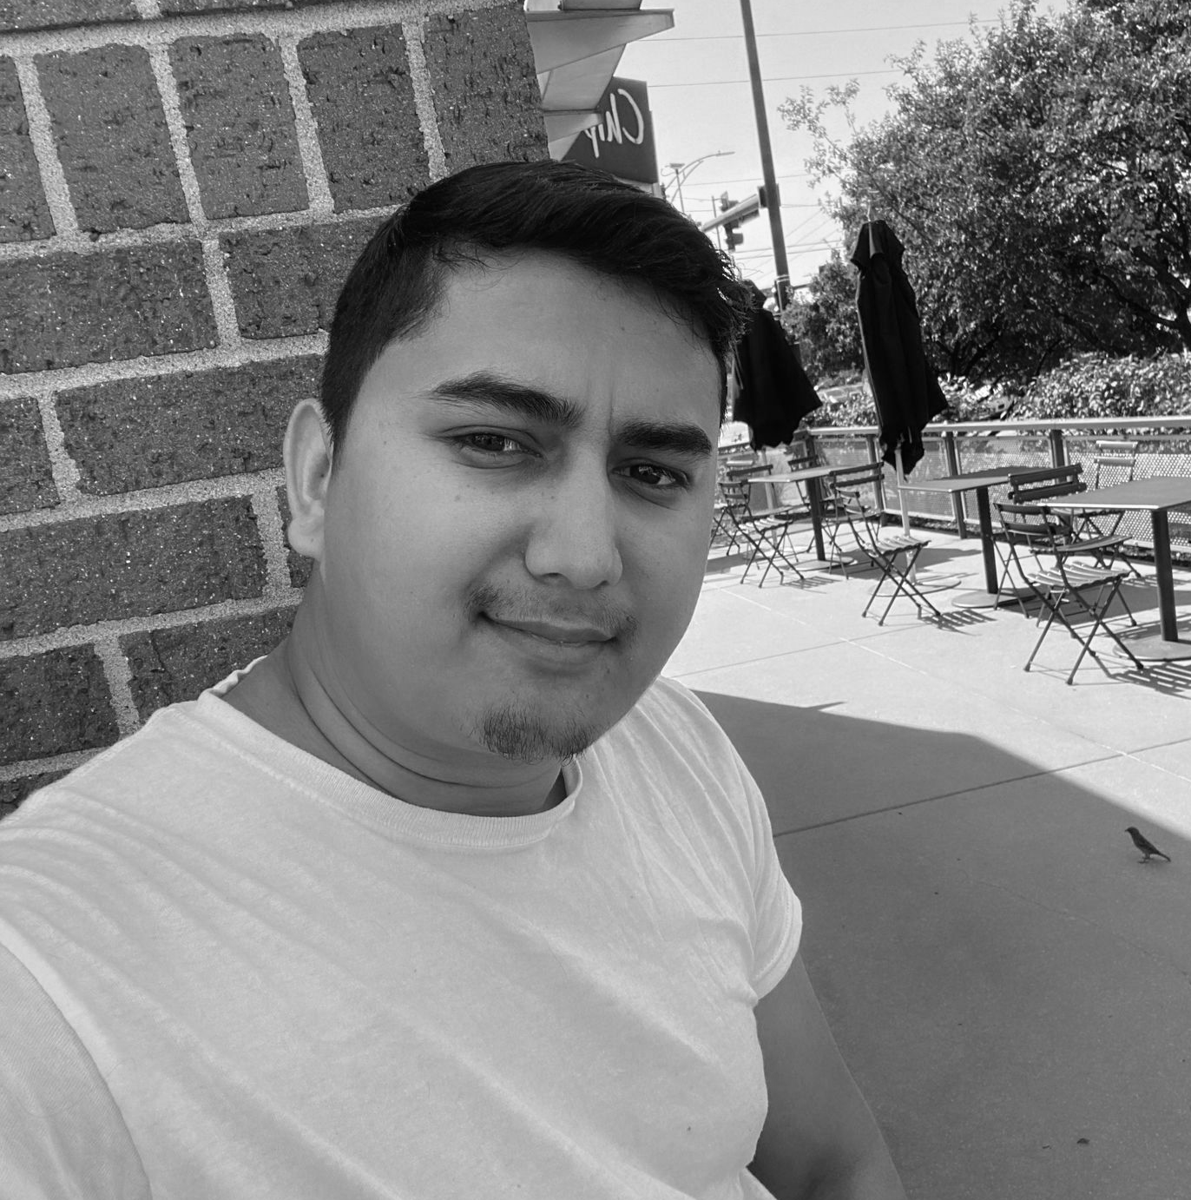
Software Life Cycle Model
Pair Programming
Research & Contributions
Shiva Karki
Computer Science
Facilitator

Slide 25
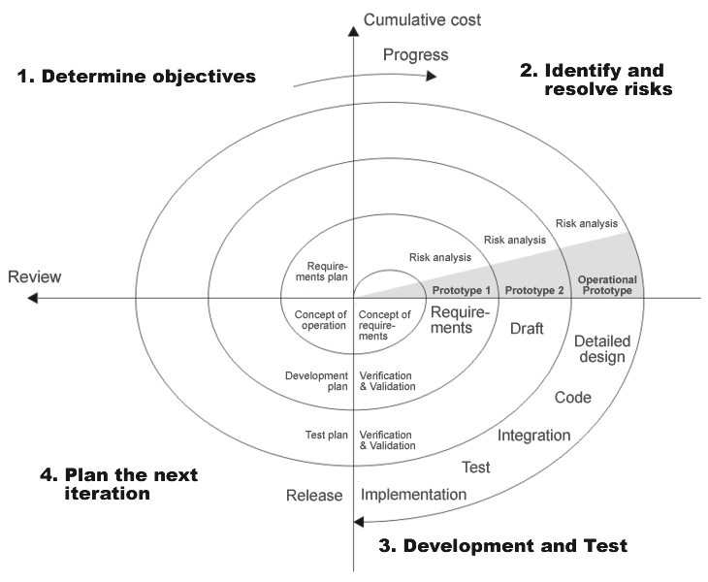
The Spiral Model

Slide 26
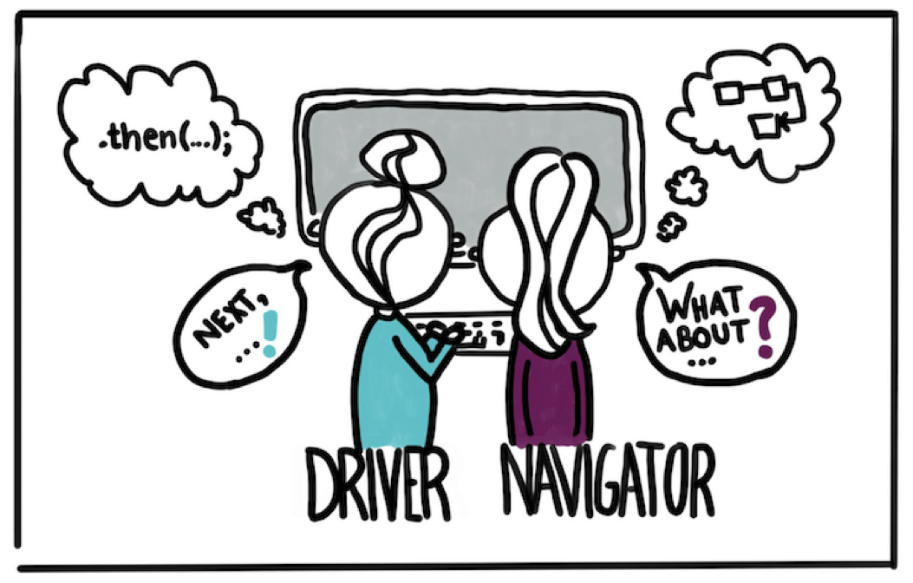
Pair Programming

Slide 27
Contributions
Research
MRC for Technologies
Prevention of Spam Entries
using Add a Test Question
Meeting Materials
Technologies on Web Pages
Discussion with Professors

Slide 29
Potential Legal and Ethical Issues
Duplication of Copyrighted Materials
False Information
Scam Artists
Spam
Notes:
It is illegal to duplicate or use copyrighted materials without authorization of the copyright holder so we’ll try to avoid this by checking the content for plagiarism.
As this database will serve to inform students, professors, and deans about multiple projects and happenings across Wichita we need to make sure that the information being provided is legit and up-to-date.
Whenever there is some new project it will also attract a bad audience who would want to take advantage of its features and exploit loopholes in the system for their own benefit.
As the database will populate lists of important information we want to avoid spam at all costs this will avoid spam from entries and will help keep the database information clearly visible and free from any kind of manipulation and redundancies.

Slide 30
Standards Identified
The product shall adhere to the following regulatory standards:
The project will adhere to FERPA rights.
The project will adhere to ITSA regulatory standards.

Slide 31
Our take on Legal and Ethical Issues
Checking source of content
Fact checking information
Allowing limited access
Adding security functionality

Slide 32
Legal and Ethical Analysis
Compliance of data
Level of accessibility
Data update responsibility
Notes:
In addition to already existing standards like FERPA we will be making some standards on our own in accordance to the requirements of the Project. A majority of these standards will involve compliance of data, level of accessibility, and data update responsibility.
FERPA standards are to be followed along with basic IT Database standards when it comes to updates. We also need to keep in mind the legal and ethical part and keep them aligned to database standards as well as it is highly important as the database evolves.

Slide 33
Final Thoughts
Standards may change in the future and more functionality would be required as the database evolves to allow space to effectively counter legal and ethical issues.

Slide 34
Questions?
?

Slide 35
Thank you

